Slide 1
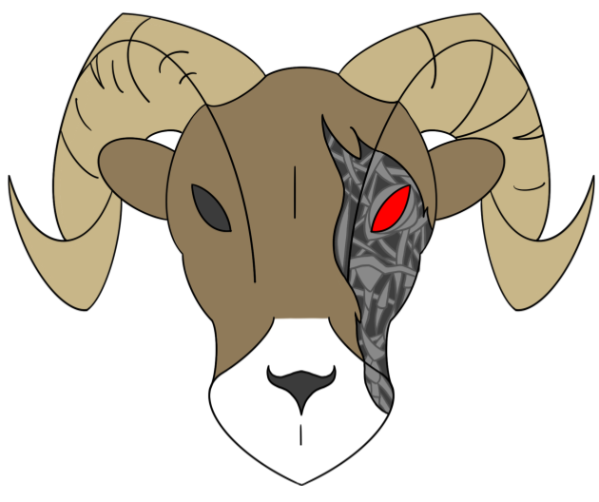
RamBOTs Mid-Project Presentation
An ECE Outreach project
Members:
Electrical: Michael Bearly, Kyle Biskupski, Alex Kolodzik
Computer: Evan Hassman, Eric Percin, Gwyndolyn Tari, Thomas Veldhuizen
Mechanical: Kyle Moore, Eric Olson
VIP’s: Anna Biolchini, Joey Reback

Slide 2
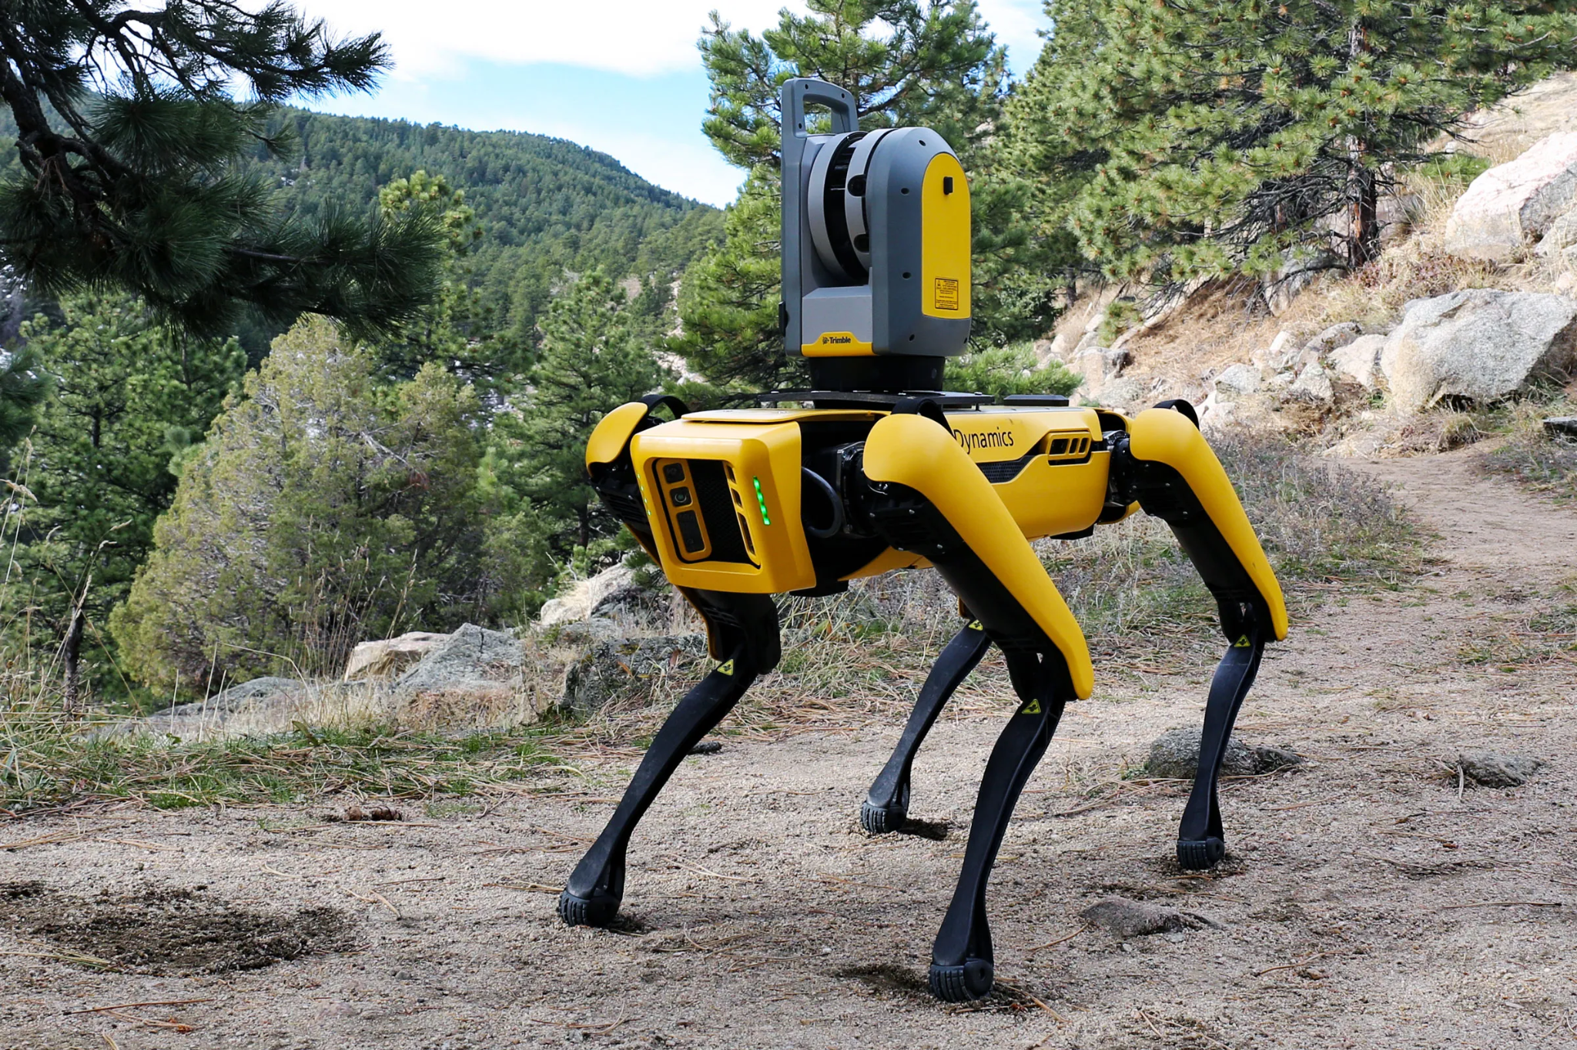

Name that robot!
https://www.bostondynamics.com/
L. Goode, “Boston Dynamics' Robots won't take our jobs ... yet,” Wired, 26-Oct-2020. [Online]. Available: https://www.wired.com/story/get-wired-podcast-14-boston-dynamics/. [Accessed: 01-Dec-2022].

Slide 3
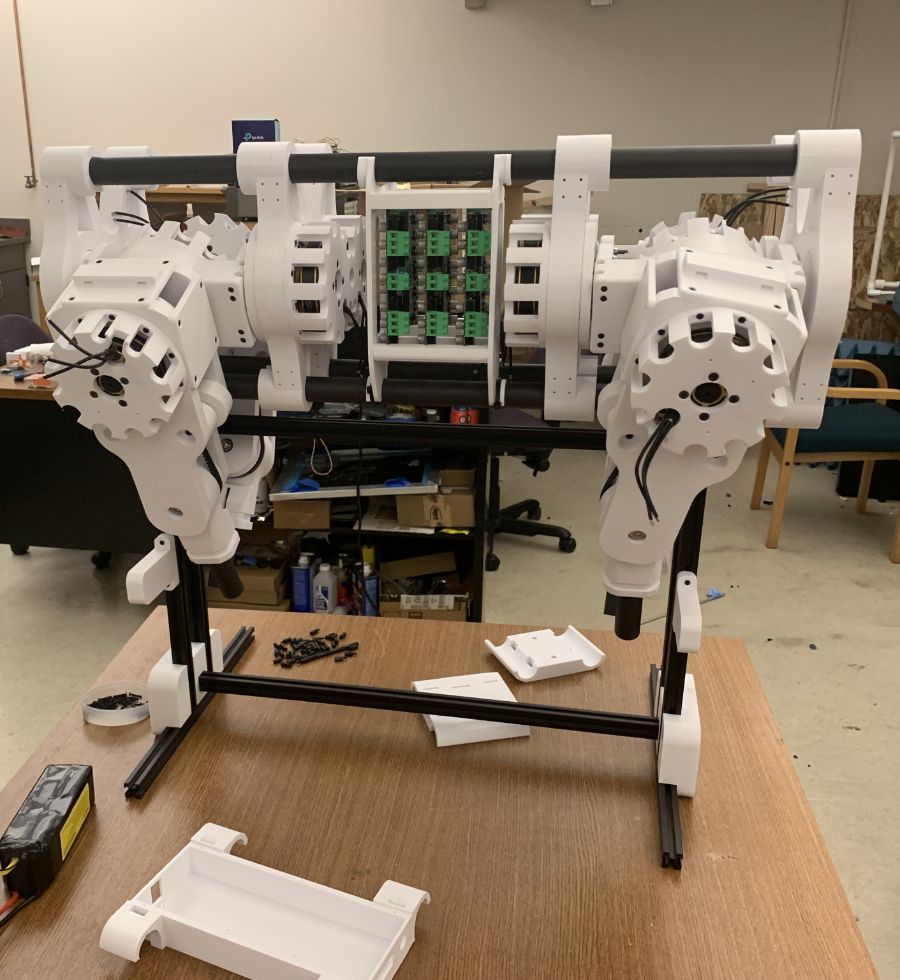
Introduction
Open Source
Quadrupedal
ECE Outreach Extension
Last Year’s Team
Goals
Movement Based
Sensors
Machine Learning

Slide 4
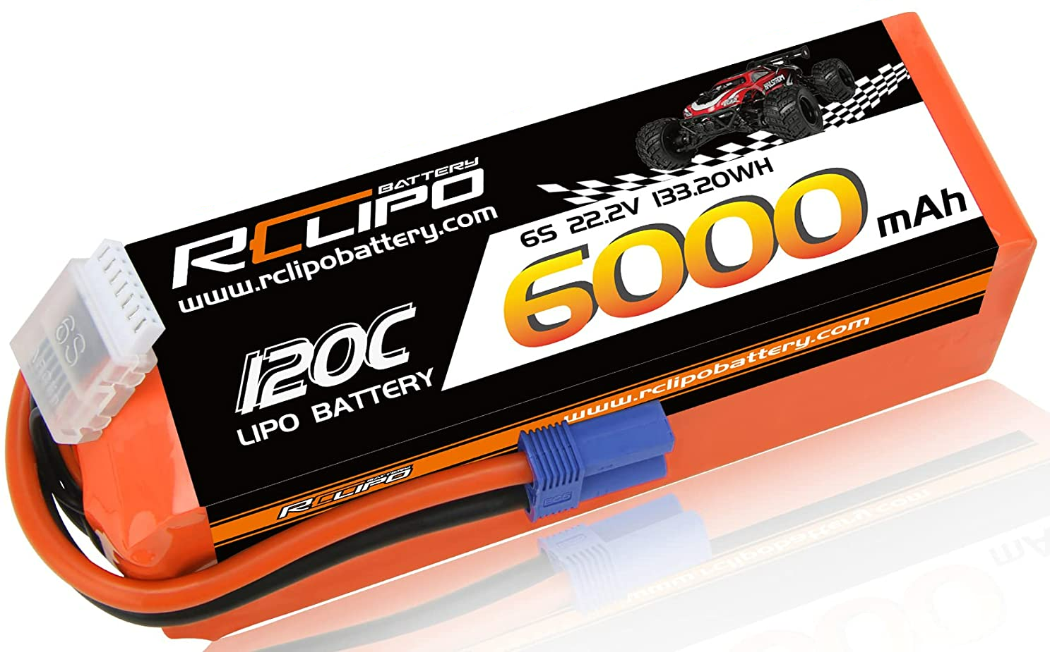
Power Design - Safety Concerns
30A breakers
One breaker per battery
Max current of 60A
10 gauge wire
battery to breaker
breaker to relay
Kill switch
Wired into relay
Low voltage battery buzzers

Slide 5
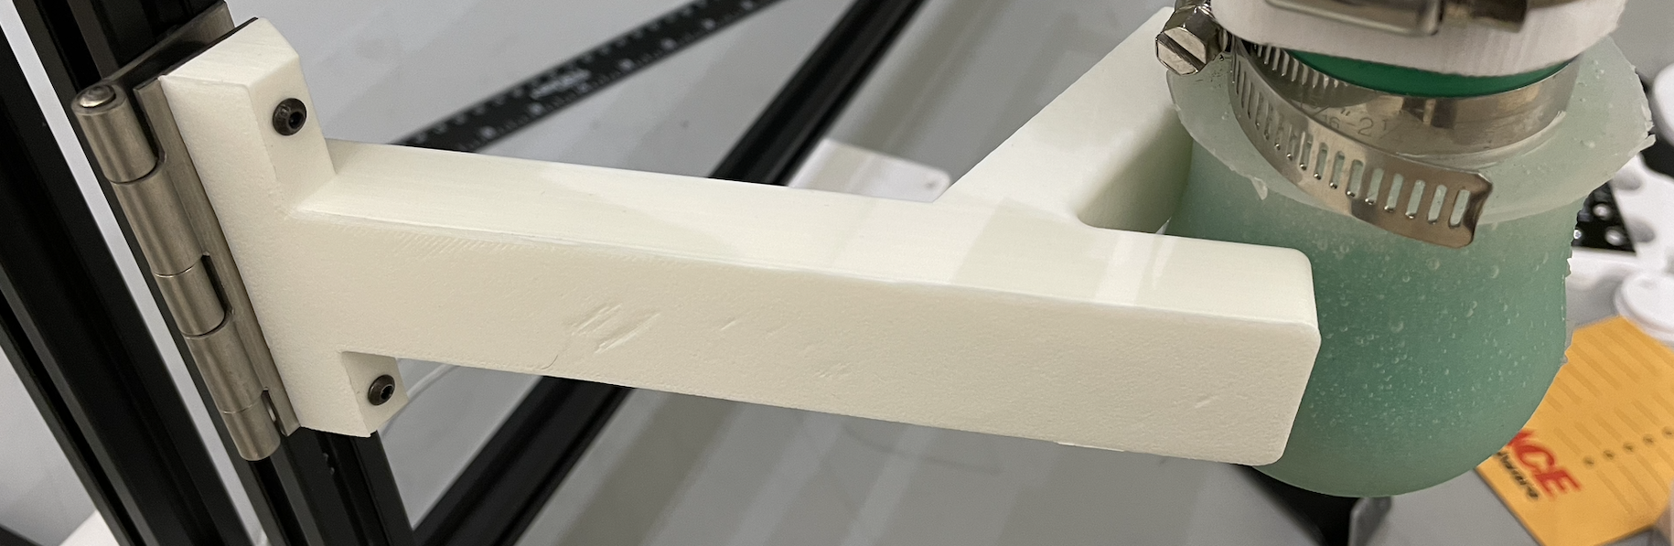
Hardware Design - Stability Improvements
Metal segments installed
Harness/stand usability improved
New rotatable leg supports
Threaded crossbar & new handles

Slide 6
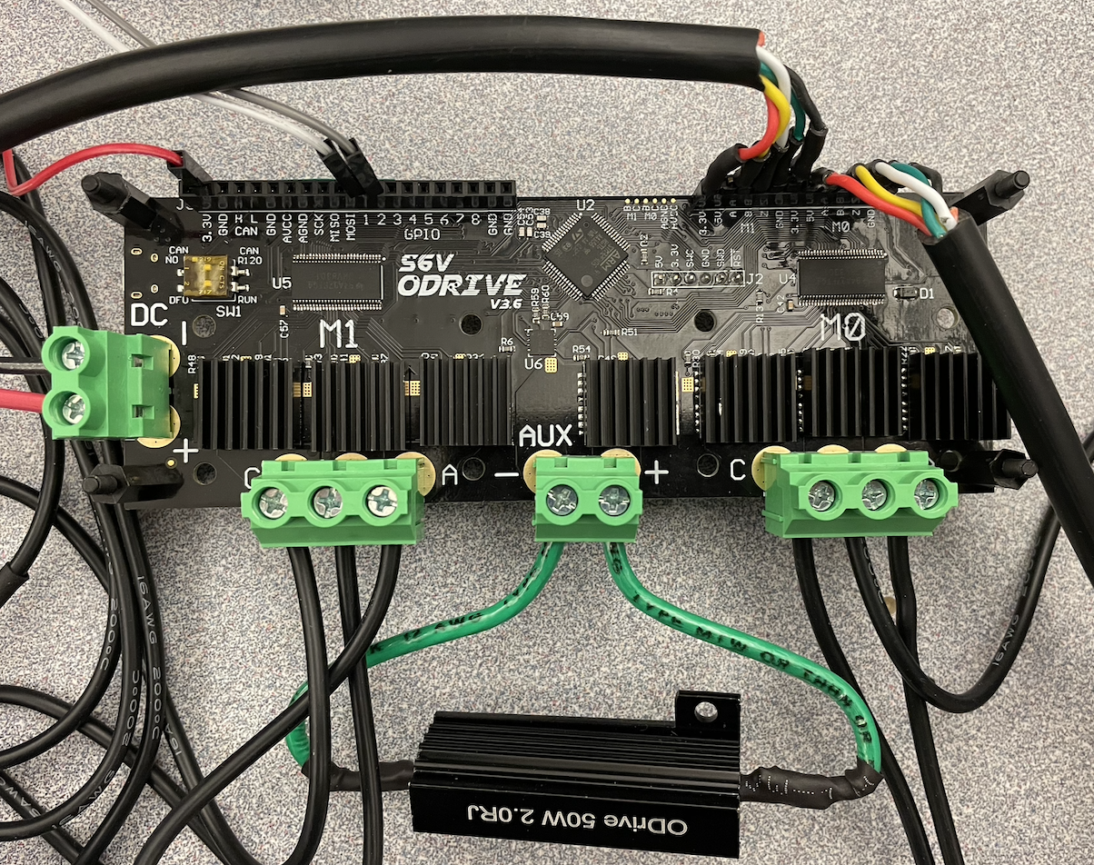
Hardware Design - Odrive Configuration
From start to now
Unit Testing
Motors
Encoder Accuracy
Adjusted configurations for O-drives
Troubleshooting Pi => Teensy => O-drive communication

Slide 7
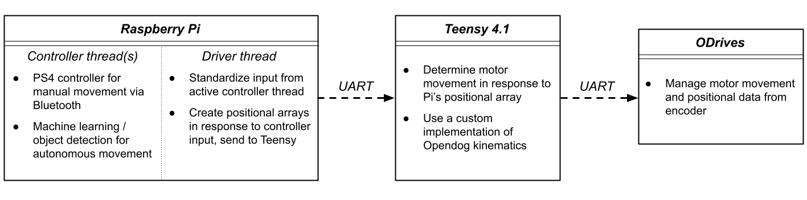
Software Design

Slide 8
Software Design- Threads
3 Threads
Controller Thread
Connected to the PS4 Controller
Talks to the Driver with a shared queue
Driver Thread
Communicates with the Teensy
Other Control Methods

Slide 9
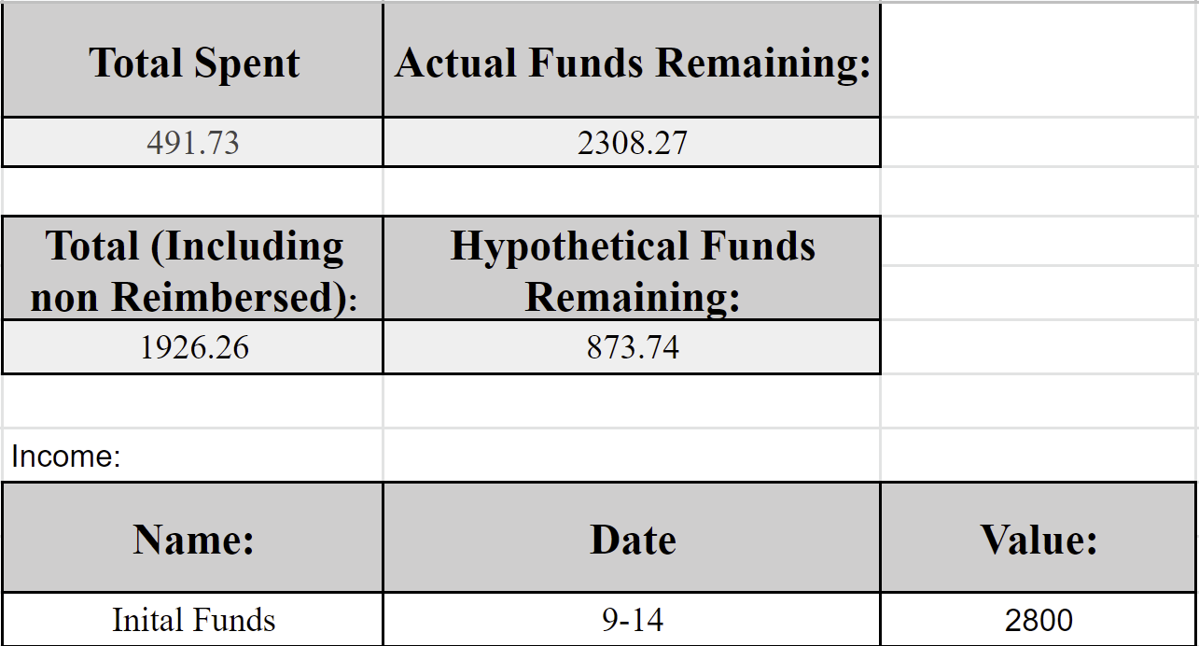
Budget
$2,800 from previous team
Last years funds
Purchases are for required items
Odrives & encoders
Safety equipment
Tools
Hypothetical includes costs that have not been reimbursed yet.

Slide 10
Summary
Objectives Completed this Semester
Added safety devices
Programmed motor movement
Further developed harness and body structure
Enabled controller inputs
Configure motors and O-drives
Objectives to Complete Next Semester
All wires and connections soldered
Combine walking code with tested code
Integrate machine learning for vision
Lots and lots of testing
Add weatherproofing and more protection to harness and robot.
VIP’s create projects for Outreach
Give the dog a name

